Slide 1
NLH update 03/31/23

Slide 2
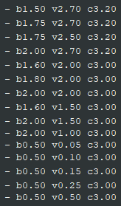
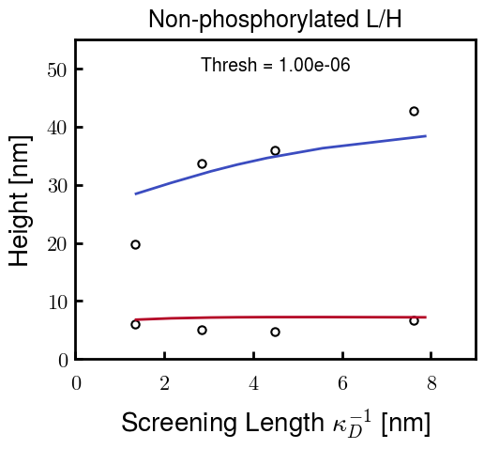


Brute force approach—Pure NFL/NFH
Choose parameters for NFL and NFH independently
NFL Possibilities
NFH Possibilities
For example,
b: Kuhn length
v: Monomer volume
c: Flory Huggins parameter for
most hydrophobic residues

Slide 3
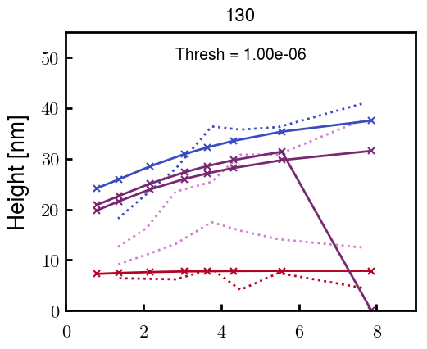
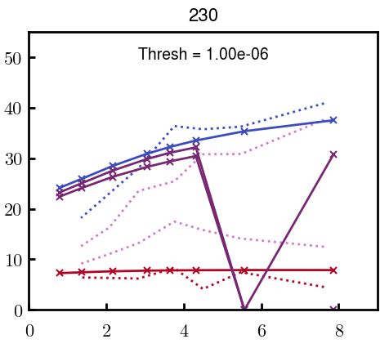
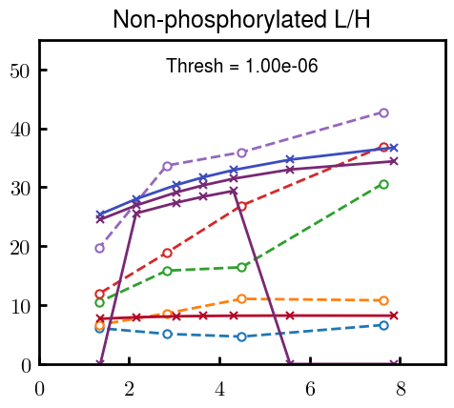
Brute force approach—Blended NFL/NFH
Some examples at L100, L80, L30, L00; ignore points with H = 0
Even with many curves that look good for the pure cases, the height profiles are consistently very non-linear with respect to L composition (from top to bottom)
Experimental heights look more or less linear with respect to NFL addition

Slide 4

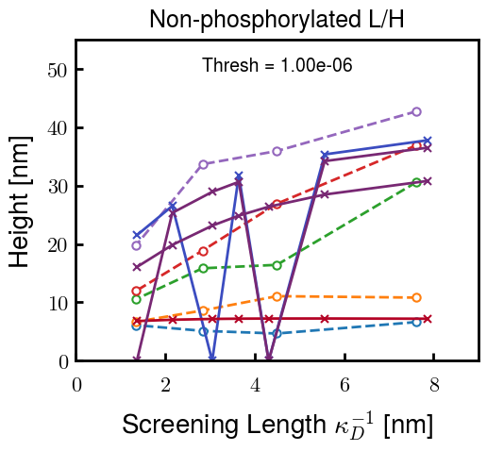
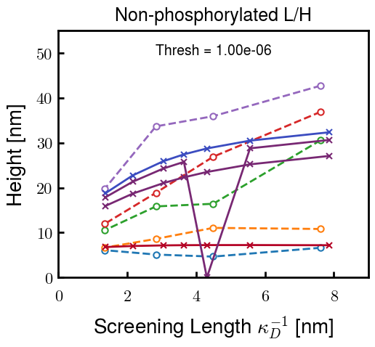
If height profiles are linear with L, shouldn’t V_L = V_H?
i.e., Replacing a charged L chain with an equal volume of neutral H chain
Can control NFL and NFH volume with both the number of Kuhn monomers N_K and the volume of Kuhn monomers \nu_K:
For i as L or H,
If the height is controlled only by volume of charge, results should be similar regardless which parameter is changed
Changing b_L
Changing \nu_L
Still very nonlinear with L
There must be a conformational reason behind the non-linear response

Slide 5
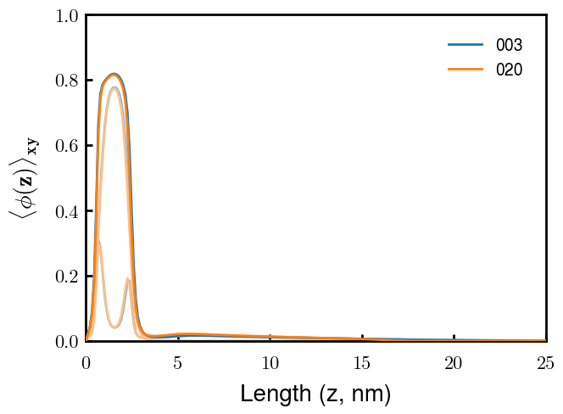
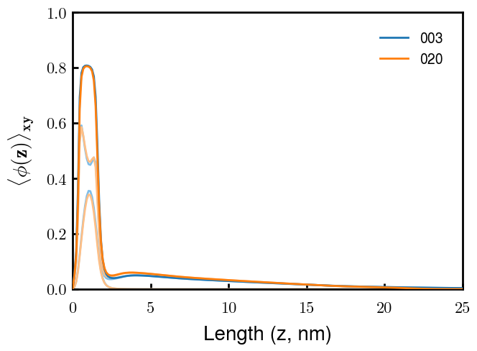
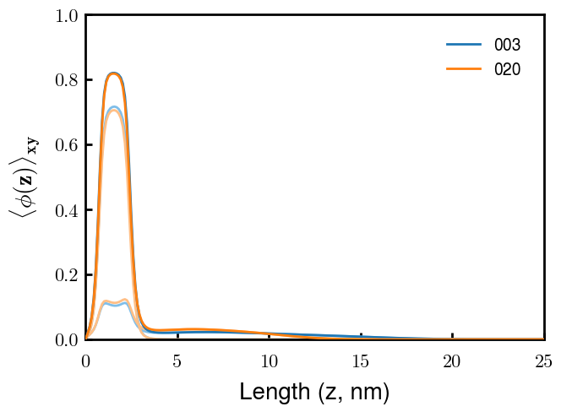
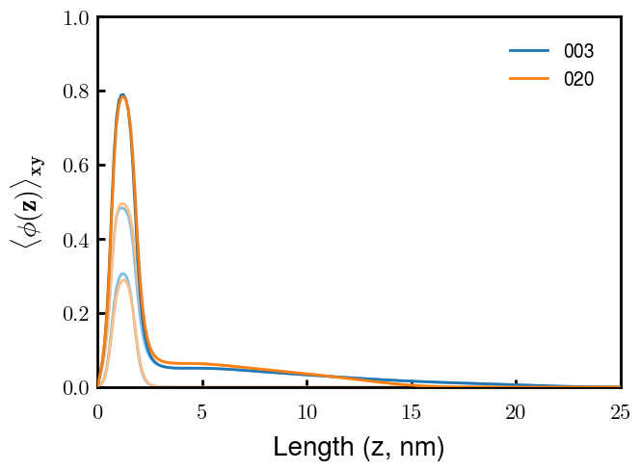
Volume fraction of the inner layer seems to saturate at \approx 0.80
L30 / H70
L80 / H20
H
L
L
H
Changing b_L (from prev. slide)
Changing \nu_L (from prev. slide)
H
L
L
H
The volume of both total protein (with respect to the grafting density) may be too high, pushing NFL out regardless of NFL/NFH properties

Slide 6




Currently trying

Slide 7
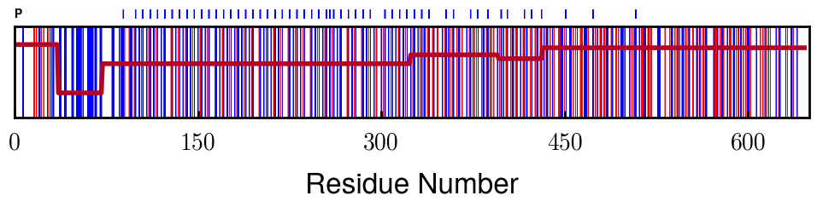
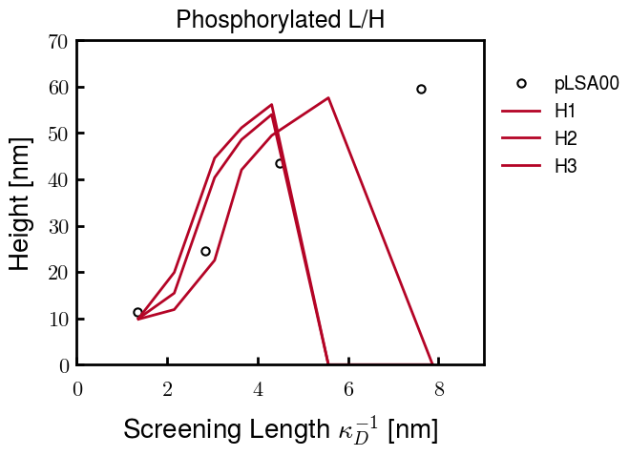
Phosphorylated NFH Progress
phosph. = - 1.5 e
Currently running one more to get a closer fit; if not, the current best one should be close enough
These parameters are close to those of the native NFH. Hopefully means that I can use the final parameters of native NFL to get the blended phosph. results
Trials
Quick note: the points that go to zero just didn’t converge. The point at 6 nm takes a really long time to converge, so I will probably proceed with only calculating from 1 to 6 nm.
In the future, if needed, I can go to 8 nm (1.6 mM)

